Slide 1

Tutorial 9

Slide 2
Topic 1
For which types of applications were NoSQL systems developed?

Slide 3
Topic 1
Social Media
User Profiles: NoSQL databases like document-oriented systems (e.g., MongoDB, CouchDB) can store and manage diverse attributes of user profiles which can vary widely from one user to another without needing a uniform schema.
Posts and Tweets: These are typically short pieces of text that may include links, media attachments, and metadata such as timestamps, geotags, and associated comments. NoSQL systems, particularly key-value and document stores, can handle this type of data efficiently by allowing quick storage and retrieval.
Web Links and Interaction Data: Graph databases (e.g., Neo4j, OrientDB) are excellent for managing the complex relationships between users, posts, comments, and shared links, as they can quickly traverse these relationships.

Slide 4
Topic 1
Marketing and Sales
Customer Data Management: Column-family stores like Cassandra and HBase offer excellent performance and scalability for handling large-scale customer data, which is crucial for marketing and sales activities.
Real-time Data Processing: Key-value stores like Redis are used for real-time data processing, useful in scenarios where customer interactions need to be captured and responded to in real-time (e.g., in-session personalization).

Slide 5
Topic 1
Road Maps and Spatial Data
Geospatial Features: Some NoSQL databases have built-in support for geospatial data types and queries. For example, MongoDB offers geospatial indexing and querying which is ideal for handling road maps and spatial data used in navigation apps and location-based services.

Slide 6
Topic 1
Email
Storage and Retrieval: Document databases can efficiently store emails which often come in varied formats and sizes. These systems can also handle large volumes of data, which is typical in email storage systems, allowing for efficient data retrieval.

Slide 7
Topic 1
Advantages of Using NoSQL in These Areas
Scalability: NoSQL databases are designed to scale out by using sharding, replication, and clustering techniques. This is crucial for applications like social media and email, which can grow exponentially.
Schema-less Model: The flexible schema of NoSQL databases allows for the storage of unstructured and semi-structured data, which is common in social media content, emails, and user-generated content.
High Performance: NoSQL databases are optimized for specific types of queries and data models, providing high performance for operations such as key-value lookups, document searches, and traversing networks of relationships.

Slide 8
Topic 1
Advantages of Using NoSQL in These Areas
Data Consistency: Depending on the NoSQL database, consistency can be a trade-off. Systems that favor eventual consistency over immediate consistency may not always serve the most up-to-date data, which can be a concern for applications requiring high levels of data integrity.
Complex Transactions: Traditional ACID transactions are challenging to implement with NoSQL systems, which may be a drawback for applications requiring complex transactional support.

Slide 9
Topic 1
1. Big Data Applications:
High-Volume Data Processing: NoSQL databases can handle large volumes of data, making them suitable for big data applications and real-time analytics.
Data Variety: They can manage structured, semi-structured, and unstructured data, providing flexibility to handle various data formats.
2. Real-Time Applications:
Low Latency: NoSQL databases often provide low-latency access to data, which is crucial for real-time applications like gaming, ad targeting, and live streaming.
High Throughput: They can handle high transaction rates to serve real-time analytics and high-speed transactions.

Slide 10
Topic 1
3. Content Management Systems (CMS):
Dynamic Content: NoSQL databases can store and manage dynamic and scalable content, such as articles, videos, and user comments in CMS.
User Profile Data: They can store user data and activity logs to provide personalized content and experiences.
4. Internet of Things (IoT) Applications:
Time-Series Data: NoSQL databases like time-series databases are suitable for storing time-ordered data generated by IoT devices.
Scalability: They can scale horizontally to accommodate the massive influx of data from numerous IoT devices.

Slide 11
Topic 1
5. Mobile Applications:
Offline Data Access: Some NoSQL databases support local data storage, enabling offline data access and synchronization for mobile applications.
Global Distribution: They can distribute data across global data centers to provide low-latency access to users worldwide.
6. E-Commerce Applications:
Catalog Management: NoSQL databases can store diverse product catalogs with various attributes.
Shopping Cart Data: They can manage shopping cart data and provide quick access to enhance the user experience.

Slide 12
Topic 1
7. Social Networking Applications:
Social Graphs: Graph databases (a type of NoSQL database) can manage social graphs and relationships efficiently.
User-Generated Content: NoSQL databases can store and manage user-generated content like posts, images, and comments.
8. Personalization and User Profiling:
User Behavior Tracking: NoSQL databases can store user behaviors, interactions, and profiles to enable personalized experiences and recommendations.
Real-Time Recommendations: They can provide real-time analytics and recommendations based on user behavior and preferences.
Notes:
NoSQL databases were developed to handle use cases that require scalability, flexibility, and varied data models, which are challenging to achieve with traditional RDBMS in an efficient and cost-effective way. Different types of NoSQL databases (document, key-value, column-family, graph, etc.) are optimized for different use cases and offer various capabilities to meet specific application needs.

Slide 13
Topic 1
9. Cloud Computing and SaaS Applications:
Multi-Tenancy: NoSQL databases can support multi-tenancy, which is crucial for cloud and Software as a Service (SaaS) applications.
Elastic Scalability: They can scale elastically to handle varying workloads in cloud environments.
10. Log and Data Aggregation:
Log Data: NoSQL databases can store and analyze log data from various sources like web servers, applications, and networks.
Aggregated Data: They can aggregate data from different sources and provide insights and analytics.
Notes:
NoSQL databases were developed to handle use cases that require scalability, flexibility, and varied data models, which are challenging to achieve with traditional RDBMS in an efficient and cost-effective way. Different types of NoSQL databases (document, key-value, column-family, graph, etc.) are optimized for different use cases and offer various capabilities to meet specific application needs.

Slide 14
Topic 2
What are the main categories of NoSQL systems? List a few of the NoSQL systems in each category?

Slide 15
Topic 2
NoSQL databases can be categorized into several main types, each with its own specific data model and use cases. Here are the main categories of NoSQL systems along with a few examples in each category:
1. Document Stores
Document stores store data in a document-like format, often using JSON or BSON. They are schema-agnostic and allow nested data structures.
MongoDB: A widely-used open-source document store that uses a binary JSON format (BSON).
CouchDB: Known for its multi-master replication and ease of use.
RavenDB: A transactional, open-source document database.

Slide 16
Topic 2
2. Key-Value Stores
Key-value stores are simple and use a hash table where each key is unique, and the value can be a JSON, BLOB, string, etc.
Redis: An in-memory data structure store, used as a database, cache, and message broker.
DynamoDB: A managed key-value and document database service provided by Amazon Web Services (AWS).
Riak KV: A distributed NoSQL key-value database that is optimized for high availability and scalability.

Slide 17
Topic 2
3. Column-Family Stores
Column-family stores allow storing of data with keys mapped to values and the values grouped into multiple families of columns.
Cassandra: A highly scalable, distributed NoSQL database system, initially developed by Facebook.
4. Graph Databases
Graph databases are designed to handle data whose relations are best represented as a graph and have elements interconnected with a finite number of relations between them.
Neo4j: A popular open-source graph database that uses Cypher Query Language.
ArangoDB: A multi-model database that supports graph, document, and key-value data models.
OrientDB: A multi-model NoSQL database management system which can manage modern, complex, interconnected data.

Slide 18
Topic 2
5. Object-Oriented Databases
Object-oriented databases store data as objects, similar to object-oriented programming.
db4o (database for objects): An embeddable open-source object database for Java and .NET developers.
ObjectDB: A powerful Object-Oriented Database Management System (ODBMS) for Java.
Versant Object Database: An object database management system that supports high-performance complex-event processing applications.

Slide 19
Topic 2
6. Multi-Model Databases
Multi-model databases support multiple data models (like document, graph, key-value, etc.) within the same database engine.
ArangoDB: (Also mentioned in Graph Databases) It supports document, graph, and key-value data models.
OrientDB: (Also mentioned in Graph Databases) It supports document, graph, and key-value data models.
Couchbase: A distributed NoSQL cloud database that supports key-value and document data models.
Different NoSQL databases are designed to solve different sets of problems, and the choice between them should be made based on the specific needs and use cases of the application.

Slide 20
Topic 3
What is the CAP theorem? Which of the three properties (consistency, availability, partition tolerance) are most important in NoSQL systems?

Slide 21
Topic 3
What is the CAP theorem? Which of the three properties (consistency, availability, partition tolerance) are most important in NoSQL systems?
CAP Theorem
The CAP theorem, proposed by computer scientist Eric Brewer, states that it is impossible for a distributed data store to simultaneously provide more than two out of the following three guarantees:
Consistency (C): All nodes in the system see the same data at the same time, meaning that a read will return the most recent write for a given data item.
Availability (A): Every non-failing node returns a response for all read and write requests in a reasonable amount of time.
Partition Tolerance (P): The system continues to function even when network partitions occur, meaning communication between nodes in the system is partially or fully disrupted.

Slide 22
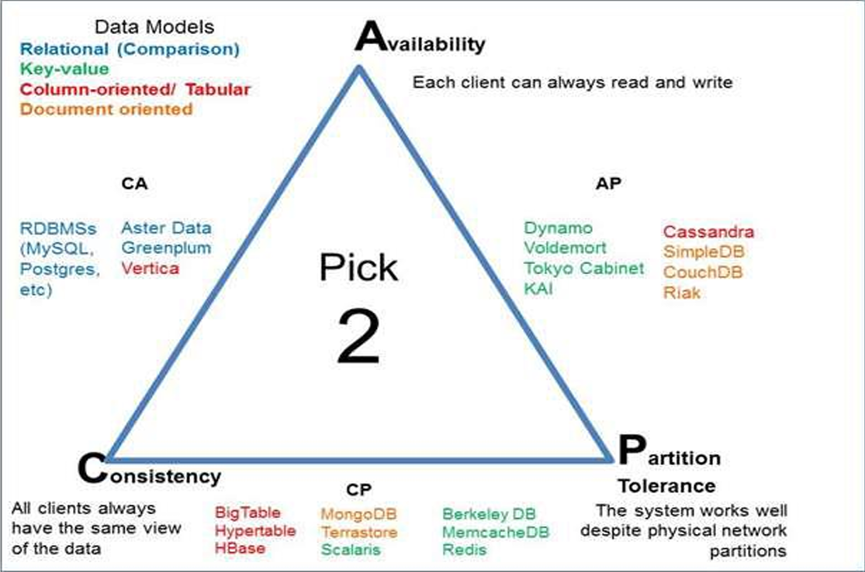

Slide 23
Topic 3
Trade-offs and Choices
Different NoSQL databases might prioritize different aspects of the CAP theorem based on their design principles and intended use cases:
Some systems might prioritize Consistency and Partition Tolerance (CP), making them suitable for use cases where data accuracy is critical.
Others might prioritize Availability and Partition Tolerance (AP), making them suitable for use cases where continuous access to the system is more important than absolute data accuracy.
It's essential to note that the choice between consistency and availability (in the face of network partitioning) is often a spectrum, and many databases allow for tuning between the two based on specific requirements. The decision about which properties to prioritize should be driven by the specific needs and context of the application being developed.

Slide 24
Topic 4
What are the similarities and differences between using consistency in CAP versus using consistency in ACID?

Slide 25
Topic 4
What are the similarities and differences between using consistency in CAP versus using consistency in ACID?
The terms "consistency" in the context of the CAP theorem and ACID properties refer to different aspects of database management, although they both deal with ensuring that a database remains in a valid state. Let's explore the similarities and differences:
Consistency in CAP Theorem
Context: The CAP theorem pertains to distributed databases and deals with how a database performs in a distributed network, especially during network failures or partitions.
Definition: In the CAP theorem, "Consistency" refers to every read receiving the most recent write (including the updates). In a consistent system, all nodes in the network see the same data at the same time.
Focus: The focus here is on ensuring that all users have a uniform view of the data, even in the presence of network partitions or failures.

Slide 26
Topic 4
Consistency in ACID Properties
Context: ACID properties (Atomicity, Consistency, Isolation, Durability) are set to guarantee that database transactions are processed reliably, typically within the context of a single database.
Definition: In ACID, "Consistency" ensures that a transaction brings a database from one valid state to another, adhering to predefined rules and constraints. If a transaction would violate these constraints, it is rolled back, and the database remains unchanged.
Focus: The focus here is on ensuring that each transaction maintains the integrity and rules of the database, ensuring that the database remains in a valid state after each transaction.

Slide 27
Topic 4
Similarities
Data Integrity: Both types of consistency aim to ensure data integrity, albeit in different contexts and scopes. CAP consistency aims to maintain data integrity across distributed nodes, while ACID consistency focuses on maintaining data integrity within the boundaries of transactional operations.
Reliability: Both are concerned with providing reliable systems – ensuring that data is accurate and valid whether within a single transaction (ACID) or across a distributed system (CAP).

Slide 28
Topic 4
Differences
Scope: CAP consistency is concerned with distributed systems and deals with the challenge of maintaining data integrity across all nodes in a network. ACID consistency is concerned with maintaining data integrity within the scope of single database transactions.
Use-Case: CAP is typically applied in the context of NoSQL databases in distributed environments, while ACID properties are often associated with traditional RDBMS (Relational Database Management Systems).
Network Failure Handling: CAP consistency involves considerations for handling network partitions and ensuring that all nodes reflect the same data. ACID consistency does not deal with network partitions as it is typically applied in the context of single, monolithic databases.
Trade-offs: In CAP, there’s a trade-off between consistency and availability when a network partition occurs. In ACID, consistency is maintained without such a trade-off within the context of individual transactions.
In summary, while both types of consistency aim to ensure that a database is accurate and reliable, they apply in different contexts (distributed systems vs. single-database transactions) and have different considerations and implications for system design and management.

Slide 29
Topic 5
Describe the execution workflow of the MapReduce programming environment.

Slide 30
Topic 5
Describe the execution workflow of the MapReduce programming environment.
MapReduce is a programming model and processing technique for generating and processing large datasets that can be parallelized across a distributed cluster of computers. Developed by Google, it's particularly useful for processing large amounts of raw data, like logs, and converting it into a more usable format. The execution workflow of MapReduce involves several key steps, mainly divided into two primary phases: the Map phase and the Reduce phase. Here's a detailed breakdown:

Slide 31
Topic 5
1. Input Splitting
Data Splitting: The input data is divided into smaller chunks or splits. Each split is processed by a separate Map task.
Distribution: The data splits are distributed across the nodes in the computing cluster.
2. Map Phase
Mapping: Each Map task takes a split as input and processes it. The Map function is applied to each record in the split and produces a set of intermediate key-value pairs.
Local Storage: The intermediate key-value pairs are stored in local memory.
3. Shuffle and Sort Phase
Shuffling: The intermediate key-value pairs produced by all the Map tasks are redistributed among Reduce tasks. This is typically done by partitioning the intermediate keys using a hash function.
Sorting: The shuffled data is sorted so that all occurrences of the same key are grouped together. This is crucial for the next step, as each Reduce task will process all values associated with the same key.

Slide 32
Topic 5
4. Reduce Phase
Reducing: Each Reduce task takes the grouped intermediate data as input and processes it. The Reduce function is applied to all values associated with the same key and produces a set of output key-value pairs.
Aggregation: The output key-value pairs are typically aggregated to form the final result.
5. Output
Collection: The output key-value pairs from all the Reduce tasks are collected.
Storing: The final output is stored in a file system, typically a distributed file system like Hadoop Distributed File System (HDFS) for further analysis or usage.

Slide 33
Topic 5
Additional Notes:
Fault Tolerance: MapReduce provides fault tolerance. If a node fails during processing, the job is automatically redirected to another node to ensure the process continues smoothly.
Parallel Processing: Both the Map and Reduce phases are designed to process data in parallel, which allows MapReduce to handle very large datasets by distributing the workload across many computers.
Scalability: MapReduce can scale to process petabytes of data across thousands of nodes.

Slide 34
Example Workflow:
Input: A large dataset, for example, a set of documents.
Map: Each Map task might process a portion of the documents and output key-value pairs where the key is a word and the value is the number 1, indicating a count of 1 for that word.
Shuffle and Sort: All the key-value pairs are shuffled and sorted so that all values with the same key (the same word) are grouped together.
Reduce: Each Reduce task takes all the values for a particular word and sums them, producing a total count for each word.
Output: The final output might be a list of words and their corresponding total counts across the entire set of documents.

Slide 35
Topic 6
Describe why and why-not NoSQL.

Slide 36
Topic 6
Describe why and why-not NoSQL.
NoSQL databases have become a significant tool in managing big data, providing mechanisms to store and retrieve data in a manner that allows for high operational speed and flexible, scalable storage. However, like any technology, NoSQL databases have their advantages and disadvantages, and their utility depends on the specific use case.

Slide 37
Topic 6
Why Use NoSQL?
Scalability:
NoSQL databases are designed to expand easily and handle more queries by adding more servers in the database.
They use horizontal scaling, which means they handle more traffic by adding more servers in the database.
Flexibility:
NoSQL databases allow for storage of data in multiple ways: it can be column-oriented, document-oriented, graph-based, or organized as a KeyValue store.
The schema-less data model allows developers to create applications with more diverse data structures.
Big Data and Real-time Applications:
NoSQL databases can handle large amounts of data and transactions that require real-time processing and analytics.
They are often used in real-time applications and for providing recommendations, as they can handle data with high velocity.

Slide 38
Topic 6
Why Use NoSQL?
High-Performance:
NoSQL databases use optimized queries for their specific data model (e.g., document, graph, key-value), which can provide higher performance for certain query patterns.
They often allow for caching of data in system memory, which significantly reduces the data retrieval times.
Cost-Effective:
NoSQL databases can be more cost-effective as they allow organizations to use systems (like distributed computing) that are less expensive.
Support for Dynamic Schemas:
NoSQL databases allow you to develop without initially defining a schema. This can be useful in projects where the design is expected to evolve during the development process.

Slide 39
Topic 6
Why Not Use NoSQL?
Maturity:
SQL databases have been around for decades, and as such, they have a large community, extensive testing, and a lot of stability.
NoSQL databases are newer and might not offer the same stability and features (like ACID compliance) that are expected from mature RDBMS systems.
Transactional Reliability (ACID Properties):
Traditional RDBMS systems are often ACID compliant, which ensures reliable processing of transactions.
NoSQL databases might not strictly adhere to ACID properties, which might be a requirement for certain applications (like banking or financial services).
Complexity:
Managing NoSQL solutions can be complex in terms of consistency, partition-tolerance, and dealing with issues like data duplication.
The flexibility of schema-less data models can sometimes lead to unstructured and inconsistent data.

Slide 40
Topic 6
Why Not Use NoSQL?
Security:
SQL databases have matured over decades with robust security features.
NoSQL databases are still evolving in terms of security features and might not be suitable for applications requiring intensive data security.
Standardization:
SQL has been standardized and used for decades, while NoSQL databases often use a variety of query languages, which might not be standardized.
Skill Availability:
There is a wide availability of developers and administrators skilled in SQL, while NoSQL expertise might be harder to find.

Slide 41
Conclusion:
The choice between SQL and NoSQL will largely depend on the specific requirements of the application being developed. NoSQL is often a great choice for scalable, high-performance applications, while SQL might be preferred for applications requiring mature, feature-rich databases with ACID compliance. It's also worth noting that some organizations opt for using both SQL and NoSQL databases (Polyglot Persistence) to leverage the benefits of both types of systems.

